Slide 1






Environmental Pollution
A Threat to Our Planet
Sabita Akter Koly
Department of Political Studies, SUST.
Reg No: 2022225009

Slide 2


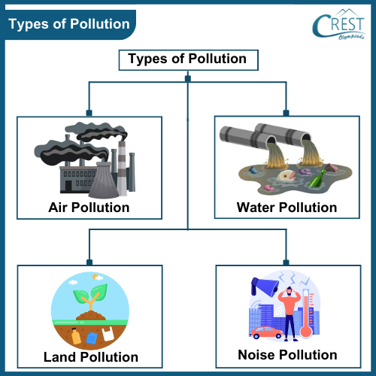

Environmental Pollution
The introduction of harmful substances or energy into the environment leading to adverse effects on ecosystems or human health.
Key Types of Pollution
Air Pollution
Water Pollution
Land Pollution
Noise Pollution
Light Pollution
NEXT SLIDE

Slide 3
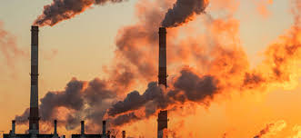
Air Pollution
Causes | Effects:
Burning of fossil fuels Industrial emissions Vehicle emissions Forest fires | Respiratory problems Acid rain Global warming Ozone layer depletion
NEXT SLIDE

Slide 4
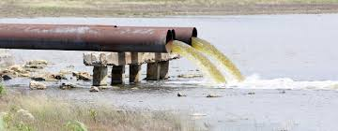
Water Pollution
Causes | Effects:
Industrial waste Agricultural runoff Sewage discharge Oil spills | Waterborne diseases Eutrophication Marine life degradation Water scarcity
NEXT SLIDE

Slide 5
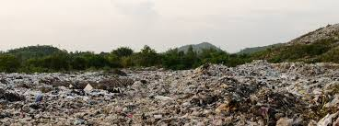
Land Pollution
Causes | Effects:
Improper waste disposal Deforestation Mining activities Pesticide and fertilizer use | Soil degradation Loss of biodiversity Land degradation Health risks
NEXT SLIDE

Slide 6

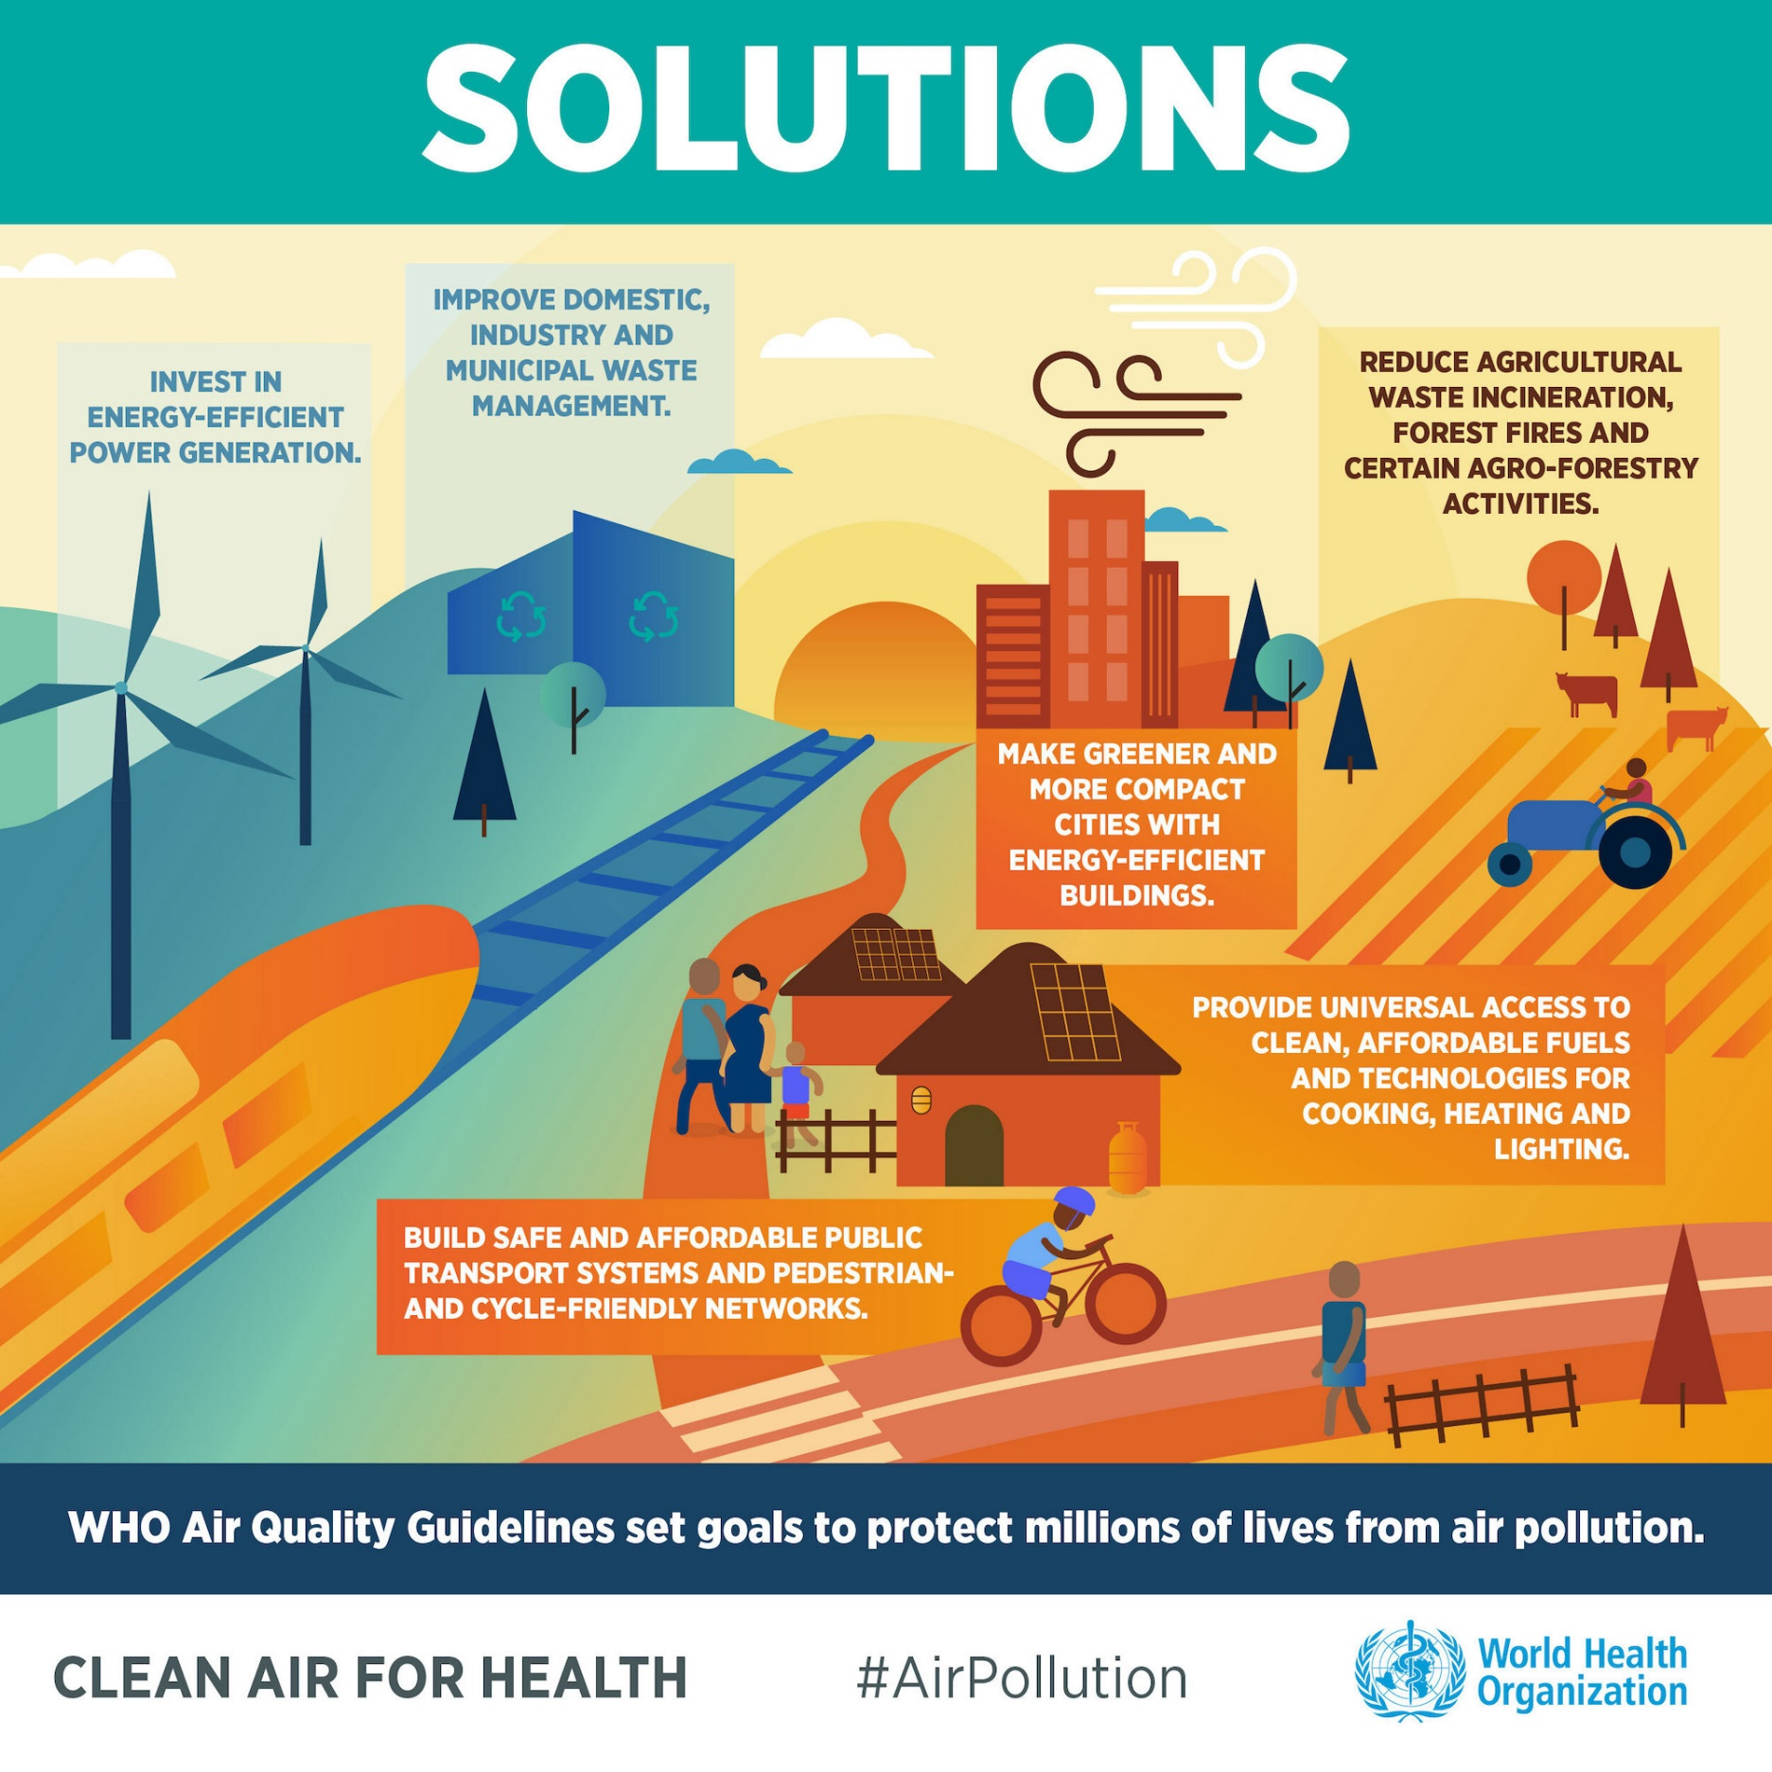

Solutions to Environmental Pollution
Reduce, Reuse, Recycle: Minimize waste and conserve resources.
Choose Sustainable Products: Opt for eco-friendly products.
Conserve Energy and Water: Reduce your carbon footprint.
Support Renewable Energy: Encourage the use of clean energy sources.
Plant Trees: Contribute to reforestation and carbon sequestration.
Educate and Advocate: Spread awareness and promote environmental policies.
NEXT SLIDE

Slide 7

THANK YOU!

